Slide 1

Regression: Least Squares Fit

Slide 2


Interpolation
Interpolation is used to estimate data points between two known points
Known points
?
?
?

Slide 3
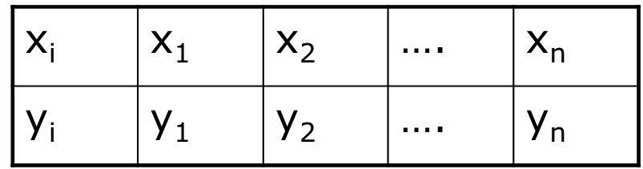
Regression
Regression analysis is a powerful statistical method that allows you to examine the relationship between two or more variables of interest.
y
x
Linear Regression
Quadratic Regression

Slide 4









Curve Fitting
Curve fitting is the process of finding a mathematical function in an analytic form that best fits this set of data.
Mathematical Model
Data
Curve Fitting is all about fitting data to a mathematical Model

Slide 5
Motivation
Given a set of experimental data:
x | 1 | 2 | 3
y | 5.1 | 5.9 | 6.3
The relationship between x and y may not be clear.
Find a function f(x) that best fit the data
1 2 3

Slide 6
Curve Fitting
Given a set of tabulated data, find a curve or a function that best represents the data.
Given:
The tabulated data
The form of the function
The curve fitting criteria
Find the unknown coefficients
e.g., least squares
regression

Slide 7
Least Squares Regression
The curve fitting criteria
Linear Regression
‌Fitting a straight line to a set of paired observations:
(x₁, y₁), (x₂, y₂),…,(x_{n}, y_{n}).
y=a₀+a₁x+e
a₁-slope.
a₀-intercept.
e-error, or residual, between the model and the observations.
The tabulated data
The form of the function
Linear Regression is the process of finding a line that best fits the data points available on the plot

Slide 8
Selection of the Functions
y
x
Quadratic Regression

Slide 9
Least Squares Regression
Given:
x_{i} | x₁ | x₂ | …. | x_{n}
y_{i} | y₁ | y₂ | …. | y_{n}
The form of the function is assumed to be known but the coefficients are unknown.
The difference is assumed to be the result of experimental error.

Slide 10
Determine the Unknowns
Linear Regression

Slide 11
Determine the Unknowns

Slide 12
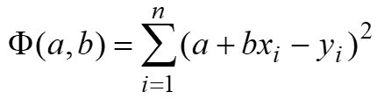
Determining the Unknowns

Slide 13
Normal Equations

Slide 14
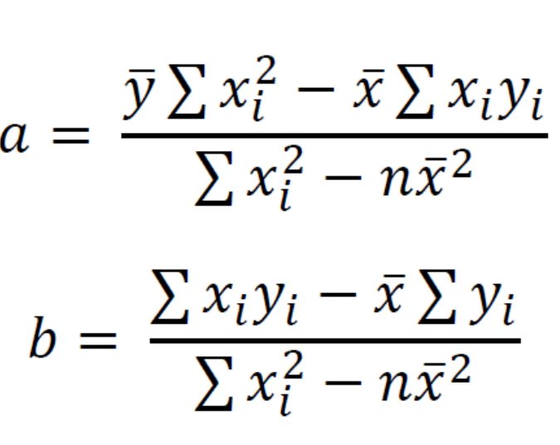
Solving the Normal Equations
≡

Slide 15
Example 1: Linear Regression
x | 1 | 2 | 3
y | 5.1 | 5.9 | 6.3

Slide 16
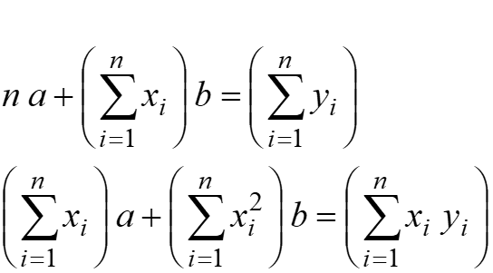
Example 1: Linear Regression
i | 1 | 2 | 3 | sum
x_{i} | 1 | 2 | 3 | 6
y_{i} | 5.1 | 5.9 | 6.3 | 17.3
x_{i}² | 1 | 4 | 9 | 14
x_{i} y_{i} | 5.1 | 11.8 | 18.9 | 35.8
17.3
6
14
35.8

Slide 17
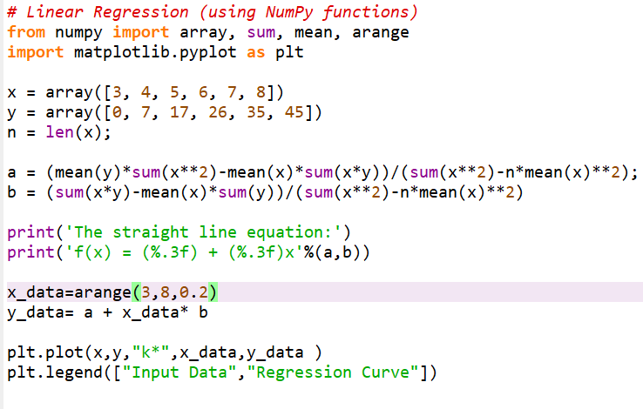
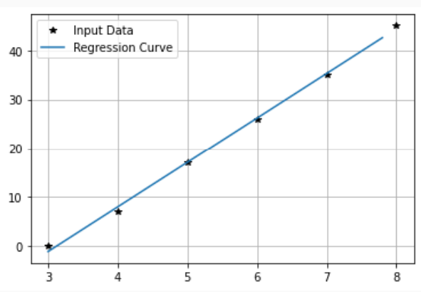


Slide 18
Multiple Linear Regression
t | 0 | 1 | 2 | 3
x | 0.1 | 0.4 | 0.2 | 0.2
y | 3 | 2 | 1 | 2
Example:
Given the following data:
Determine a function of two variables:
f(x,t) = a + b x + c t
That best fits the data with the least sum of the square of errors.

Slide 19
Solution of Multiple Linear Regression
the sum of the square of the error

Slide 20
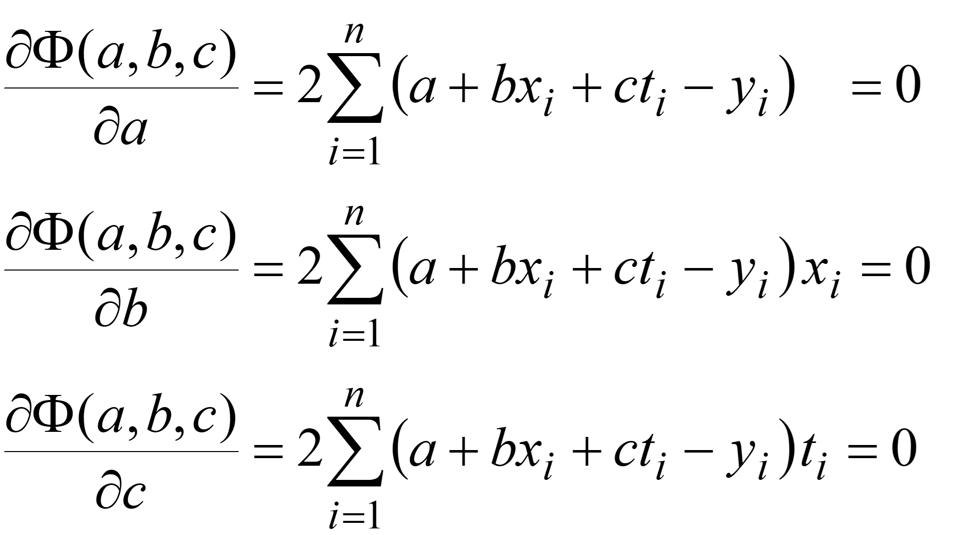
System of Equations

Slide 21
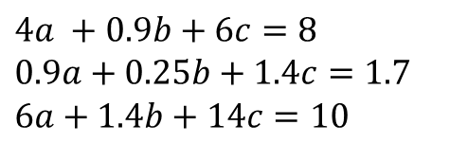
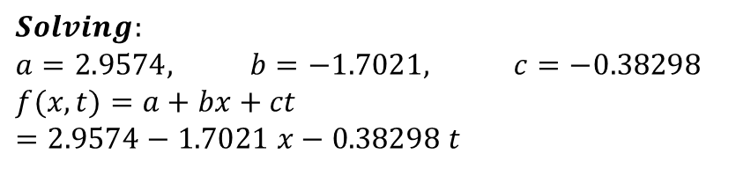
Example 2: Multiple Linear Regression
i | 1 | 2 | 3 | 4 | Sum
t_{i} | 0 | 1 | 2 | 3 | 6
x_{i} | 0.1 | 0.4 | 0.2 | 0.2 | 0.9
y_{i} | 3 | 2 | 1 | 2 | 8
x_{i}² | 0.01 | 0.16 | 0.04 | 0.04 | 0.25
x_{i} t_{i} | 0 | 0.4 | 0.4 | 0.6 | 1.4
x_{i} y_{i} | 0.3 | 0.8 | 0.2 | 0.4 | 1.7
t_{i}² | 0 | 1 | 4 | 9 | 14
t_{i} y_{i} | 0 | 2 | 2 | 6 | 10
$$4a +0.9b+6c=8 \\ 0.9a+0.25b+1.4c=1.7 \\ 6a+1.4b+14c=10$$
$$Solving: \\ a=2.9574, b=−1.7021, c=−0.38298 \\ f(x,t)=a+bx+ct=2.9574−1.7021 x−0.38298 t$$

Slide 22
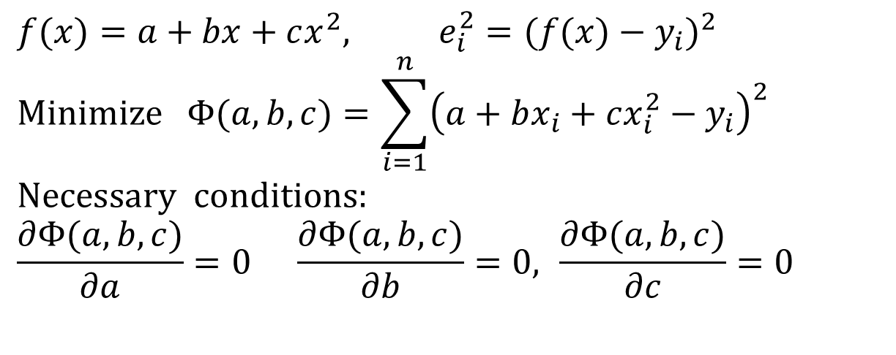
Polynomial Regression
The least squares method can be extended to fit the data to a higher-order polynomial
$$f(x)=a+bx+cx^{2}, e_{i}^{2}=(f(x)−y_{i})^{2}$$
$$\text{Minimize} Φ(a,b,c)=\sum_{i=1}^{n}{{\left(a+bx_{i}+cx_{i}^{2}−y_{i}\right)}^{2}}$$
$$\text{Necessary} \text{conditions}\text{:} \\ \frac{∂Φ(a,b,c)}{∂a}=0 \frac{∂Φ(a,b,c)}{∂b}=0, \frac{∂Φ(a,b,c)}{∂c}=0$$

Slide 23
Equations for Quadratic Regression

Slide 24
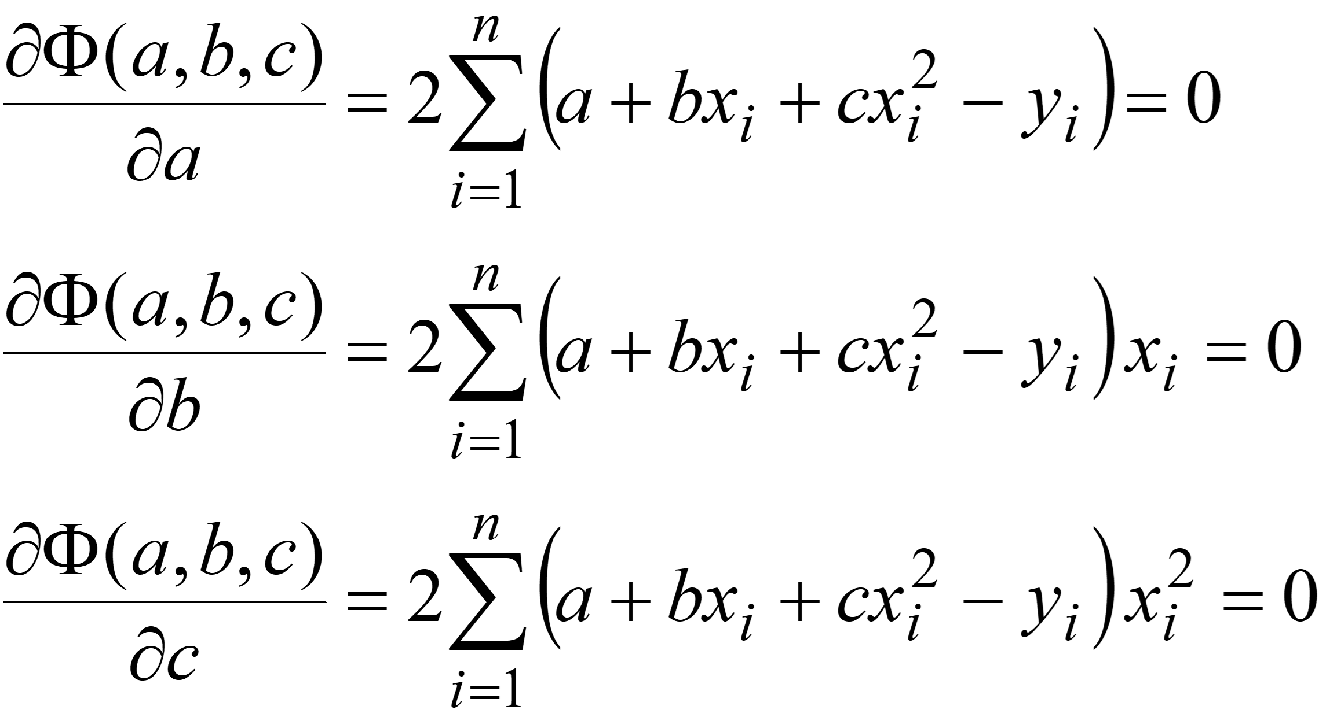
Normal Equations

Slide 25
Example 3: Polynomial Regression
Fit a second-order polynomial to the following data
x_{i} | 0 | 1 | 2 | 3 | 4 | 5 | ∑=15
y_{i} | 2.1 | 7.7 | 13.6 | 27.2 | 40.9 | 61.1 | ∑=152.6
x_{i}² | 0 | 1 | 4 | 9 | 16 | 25 | ∑=55
x_{i}³ | 0 | 1 | 8 | 27 | 64 | 125 | 225
x_{i}⁴ | 0 | 1 | 16 | 81 | 256 | 625 | ∑=979
x_{i} y_{i} | 0 | 7.7 | 27.2 | 81.6 | 163.6 | 305.5 | ∑=585.6
x_{i}² y_{i} | 0 | 7.7 | 54.4 | 244.8 | 654.4 | 1527.5 | ∑=2488.8

Slide 26
How Do You Judge Functions?

Slide 27
Example showing that Quadratic is preferable than Linear Regression
y
y
x
x
Linear Regression
Quadratic Regression

Slide 28
Curve Fitting in Python

Slide 29
Curve Fitting in Python
Python has curve fitting functions that allows us to create empiric data model.
It is important to have in mind that these models are good only in the region we have collected data.
Here are some of the functions available in Python used for curve fitting:
polyfit(), curve_fit(), …
Some of these techniques use a polynomial of degree N that fits the data Y best in a least-squares sense.

Slide 30
Linear Regression - Example
Assume the Data:
from scipy.optimize import curve_fit
def linear_model(x, a, b): return a * x + b
x = [0, 1, 2, 3, 4, 5]
y = [15, 10, 9, 6, 2, 0]
popt, pcov = curve_fit(linear_model, x, y)
print(popt)
𝑥 | 𝑦
0 | 15
1 | 10
2 | 9
3 | 6
4 | 2
5 | 0
We want to find a linear model 𝑦(𝑥) = 𝑎𝑥 + 𝑏 that fits the data points

Slide 31
Linear Regression - Example
Assume the Data:
From the Python code we get the following results:
[-2.91428571 14.28571429]
This means 𝑎 ≈ −2.91 and 𝑏 ≈ 14.29
Or:
𝑦 = −2.91𝑥 + 14.29
The curve_fit() function returns two items, which we call popt and pcov. The popt argument are the best-fit parameters (p optimal) for a and b. The pcov variable contains the covariance matrix, which indicates the uncertainties and correlations between parameters.
𝑥 | 𝑦
0 | 15
1 | 10
2 | 9
3 | 6
4 | 2
5 | 0

Slide 32
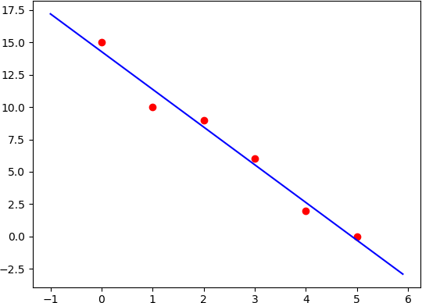
Example - Improved
import numpy as np
from scipy.optimize import curve_fit
import matplotlib.pyplot as plt
def linear_model(x, a, b):
return a * x + b
x = [0, 1, 2, 3, 4, 5]
y = [15, 10, 9, 6, 2, 0]
popt, pcov = curve_fit(linear_model, x, y)
Next, it is also a good idea to plot the actual data in the same plot as the model for comparison.
We extend the code as follows:
print(popt)
plt.plot(x,y, 'or')
xstart = -1
xstop = 6
increment = 0.1
xmodel = np.arange(xstart,xstop,increment)
a = popt[0] b = popt[1]
ymodel = a*xmodel + b
plt.plot(xmodel,ymodel, 'b')

Slide 33
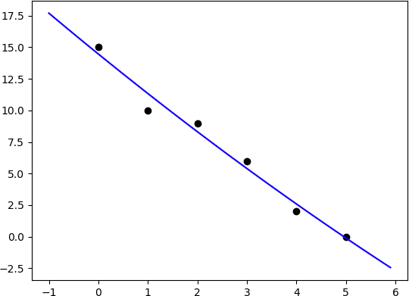
Polynomial Regression - Example
We start with a 2. order model:
𝑦(𝑥)= 𝑎𝑥² + 𝑏𝑥 + 𝑐
import numpy as np
from scipy.optimize import curve_fit
import matplotlib.pyplot as plt
x = [0, 1, 2, 3, 4, 5]
y = [15, 10, 9, 6, 2, 0]
def model(x, a, b, c):
y = a * x ** 2 + b * x + c
return y
popt, pcov = curve_fit(model, x, y)
print(popt)
plt.plot(x,y, 'ok’)
xstart = -1; xstop = 6 increment = 0.1
xmodel = np.arange(xstart,xstop,increment)
a = popt[0]; b = popt[1]; c = popt[2]
ymodel = model(xmodel, a, b, c)
plt.plot(xmodel,ymodel, 'b')
[0.05357143 -3.18214286 14.46428571]
𝑦 (𝑥) = 0.05𝑥² − 3.18𝑥 + 14.46

Slide 34
Example – Improved Solution
We start with a 2.order model:
𝑦(𝑥)= 𝑎𝑥² + 𝑏𝑥 + 𝑐
import numpy as np
from scipy.optimize import curve_fit
import matplotlib.pyplot as plt
x = [0, 1, 2, 3, 4, 5]
y = [15, 10, 9, 6, 2, 0]
def model(x, a, b, c):
y = a * x ** 2 + b * x + c
return y
popt, pcov = curve_fit(model, x, y)
print(popt)
plt.plot(x,y, 'ok’)
xstart = -1; xstop = 6 increment = 0.1
xmodel = np.arange(xstart,xstop,increment)
ymodel = model(xmodel, *popt)
plt.plot(xmodel,ymodel, 'b')
[0.05357143 -3.18214286 14.46428571]
𝑦 (𝑥) = 0.05𝑥² − 3.18𝑥 + 14.46

Slide 35


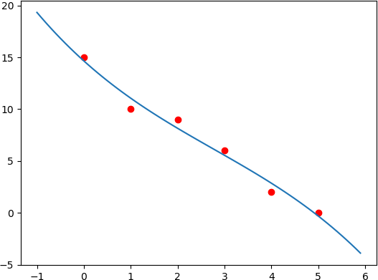
polyfit() and polyval()
In this example we will use the NumPy functions polyfit() and polyval().
We start with a 3.order model:
𝑦 (𝑥) = 𝑎𝑥³ + 𝑏𝑥² + 𝑐𝑥 + 𝑑
import numpy as np
import matplotlib.pyplot as plt
# Original Data
x = [0, 1, 2, 3, 4, 5]
y = [15, 10, 9, 6, 2, 0]
plt.plot(x,y, 'or')
# Set Model order model_order = 3
The NumPy functions polyfit() and
polyval()only works for Polynomials
# Find Model
p = np.polyfit(x, y, model_order)
print(p)
# PlottheModel xstart = -1
xstop = 6
increment = 0.1
xmodeldata =\ np.arange(xstart,xstop,increment)
ymodel = np.polyval(p, xmodeldata)
plt.plot(xmodeldata,ymodel)

Slide 36
polyfit() and polyval()
𝑥 | 𝑦
0 | 15
1 | 10
2 | 9
3 | 6
4 | 2
5 | 0
In this example we will use the NumPy functions polyfit() and
polyval().
We start with a 3.order model:
𝑦(𝑥) = 𝑎𝑥³ + 𝑏𝑥² + 𝑐𝑥 + 𝑑
We get the following results:
[-0.06481481 0.53968254 -4.07010582 14.65873016]
This means the following 3.order model:
𝑦(𝑥) = −0.06 + 0.54𝑥¹ − 4.1𝑥² + 14.7 𝑥³

Slide 37
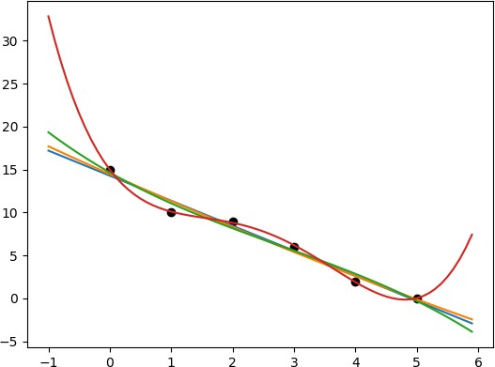
Example modified
import numpy as np
import matplotlib.pyplot as plt
# Original Data
x = [0, 1, 2, 3, 4, 5]
y = [15, 10, 9, 6, 2, 0]
plt.plot(x,y, 'ok’)
# x values for model
xstart = -1; xstop = 6 increment = 0.1
xmodel = np.arange(xstart,xstop,increment)
startorder = 1
endorder = 5
for model_order in range(startorder, endorder, 1):
# Finding the Model
p = np.polyfit(x, y, model_order)
print(p)
# Plot the Model
ymodel = np.polyval(p, xmodel)
plt.plot(xmodel,ymodel)
Let's extend the code by creating different models with different orders. For easy comparison of different models in the same program we can use a For loop as shown in the code example.

Slide 38
Least Square Method

Slide 39
Least Square Method (LSM)
The least squares method requires the model to be set up in the following form based on input-output data :
𝑌 = Φ𝜃
The Least Square fit
The Least Square Method is given by:
𝜃_{𝐿𝑆} = (Φ^{𝑇}Φ )⁻¹Φ^{𝑇}𝑌
Data Points
pseudo-inverse of Φ

Slide 40
LSM Example
Given the following Data:
The Least Square fit
𝑥 | 𝑦
0 | 15
1 | 10
2 | 9
3 | 6
4 | 2
5 | 0
𝑦 = 𝑎𝑥 + 𝑏
𝑦 = 𝑎𝑥 + 𝑏
We need to find 𝑎 and 𝑏
Data Points
15 = 𝑎 K 0 + 𝑏
10 = 𝑎 K 1 + 𝑏
9 = 𝑎 K 2 + 𝑏
6 = 𝑎 K 3 + 𝑏
2 = 𝑎 K 4 + 𝑏
0 = 𝑎 K 5 + 𝑏
15 0 1
₁₀ 1 1
9 ₌ 2 1
6 1
2 1
0 1
𝑎
𝑏
3
4
5
𝑌 = Φ𝜃
𝑌 = Φ𝜃
The Least Square Method is given by:
𝜃_{𝐿𝑆} =(Φ^{𝑇}Φ)⁻¹Φ^{𝑇}𝑌

Slide 41
Python Code
Return the least-squares solution to a linear matrix equation. Computes the vector x that approximately solves the equation a x = b
𝑌 = Φ𝜃
The Least Square Method is given by:
𝜃_{𝐿𝑆} =(Φ^{𝑇}Φ)⁻¹Φ^{𝑇}𝑌

